Slide 1
CAR Calibration Meeting CAR Review
AP Team
Tony Hsu, Motomu Kawano, Samantha Bang and Erica Qin
September 17, 2014

Slide 2
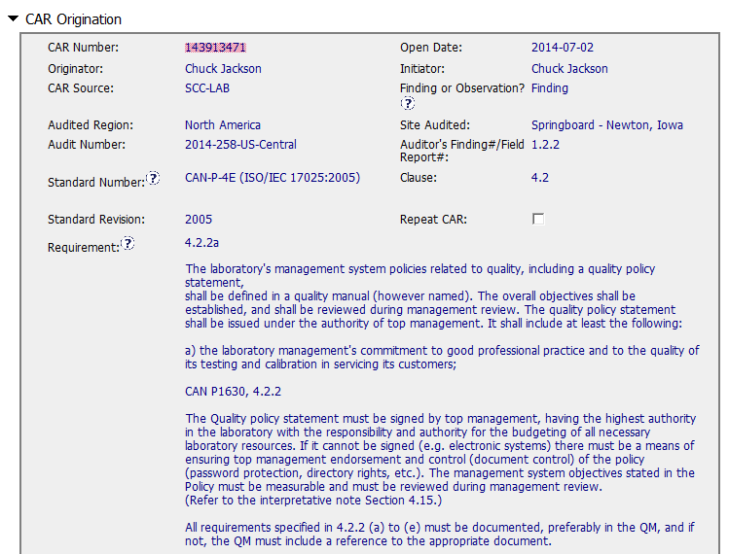
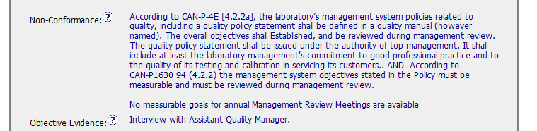
CAR No. 143913471 (1) _Finding
Non-conformance: repeat the requirements again, should identify areas that disobeyed to requirements.
The issue include : “the stated goals of the Quality Policy have not been discussed during the annual Management Review in past years; did not specifically discuss the goals…….”(referring to following “Analysis” part).
NC -“No measurable goals for annual MR ” whether means lacking overall objectives- to be confirmed.
Objective Evidence : should be more complete and clear with the facts. ( eg. the date of MR meeting, the contents of minutes reviewed. ).
Notes:
00-QA-S0006 (#18.0) - Corrective Action Request Process

Slide 3
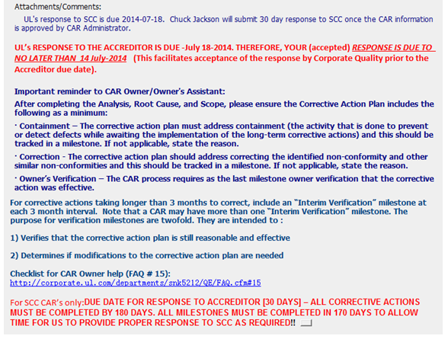
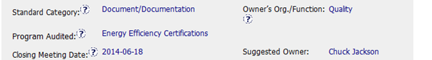
CAR No. 143913471 (2)
The reminder to owner is very clear, easily identify the different response due date requirement for UL internal and for accreditor(SCC).
1
Standard Category: was not appropriate selected ,
should be related to 4.2 Management System
Notes:
00-QA-S0006 (#18.0) - Corrective Action Request Process

Slide 4
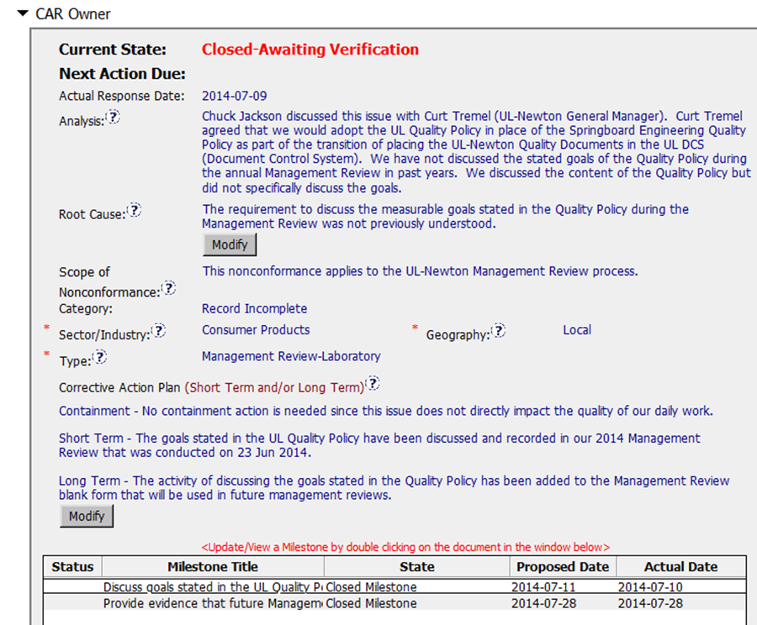
CAR No. 143913471 (3)
Root cause is not based upon the analysis. “The requirement was not previously understood” was not mentioned in the “Analysis” field. Need explore further.
Scope should also tell how long NC lasted .
Category: depends to the correct root cause naturally flew from analysis.
“Record incomplete” selected is not right category related to “not understood requirement” issue.
Analysis - couldn’t show clear path to root cause.
Key stakeholders identified (Quality/GM), operation, lab, customer advocacy function leader not involved in the analysis.
It’s impropriate to jump to the actions “we would adopt the UL Quality Policy(QP in place of Springboard Engineering QP….”.
Should utilize “5 WHYs” approach by deeper investigation, including whether this requirements(4.2.2) on “overall objectives shall be established and reviewed in MR“ been communicated before? ISO 17025 refresh training conducted or not ? clearly understood by stakeholders? whether the responsibility/duty on above 4.2.2 being identified and implemented by owners ?
- Lacking analyze how widespread the problem is, any affect being caused.
(T) Most appropriate ‘category’, ‘type’, ‘geography’ are selected – Need improve for ”category’
(C) Analysis shows clear path to root cause and scope; stakeholders identified – Need improve
(C) Root cause statement is succinct, reasonable, complete (Shows ‘N/A’ for observations) – Moderate
Notes:
00-QA-S0006 (#18.0) - Corrective Action Request Process

Slide 5
CAR No. 143913471 (3)
Corrective Actions Plan:
•- -Milestone 1: Containment Action: “no measurable goals” issue could be notified by mail to arise attention of all stakeholders. “not reviewed goals/objectives in MR” issue to be fixed by using new form 62-LO-F0868 (as per Milestone 2.)
Also need take related actions referring to above “Analysis” filed - “We would adopt the UL Quality Policy in place of Springboard Engineering Quality Policy– To be confirmed.
•- - Milestone 2: Short term / Long term: to address the problems by establishing objectives and reviewing in MR meeting.
Also address entire root cause if being identified as “not understood the requirements” by communication/training effectively to enhance stakeholders awareness on 4.2.2“management system” requirements.
•- -Milestone 3: Should have final milestone for owner’s verification of effectiveness.
(C) Corrective actions fix the objective evidence and other problems found (Moderate); address entire root cause and scope (Need improve).
(C) Milestones address containment & owner’s verification – Need improve
Notes:
00-QA-S0006 (#18.0) - Corrective Action Request Process

Slide 6
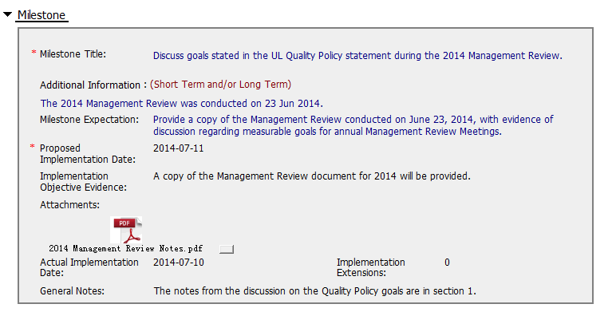
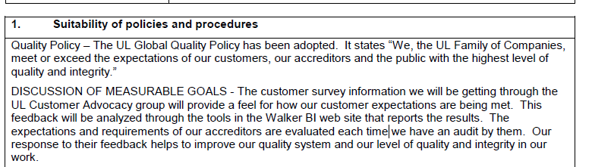
CAR No. 143913471 (4)_(Milestone 1 )
Milestone 1 limited to resolve the “reviewing in MR meeting” issue ,not resolve “ measurable goals set-up “ Issue.
Suggest “Expectation” should also focus on:
- Providing the evidence that how the Overall Objectives being established based on data collection or facts
The overall objectives can be preferably documented in QM , or shown in another separate document being controlled.
- The communication records for the measurable goals/objectives ,ensure the staff well understand its relation to their daily work
The attachment “MR Notes” shows that goals discussed only focus on 2 items , CES analysis , response to Accreditors feedback.
Lacking measurable objectives for each item. It’s not appropriate and incomplete to be submitted to MR meeting - to be discussed.
(C) Milestones completed per milestone expectations - Excellent
Notes:
00-QA-S0006 (#18.0) - Corrective Action Request Process

Slide 7
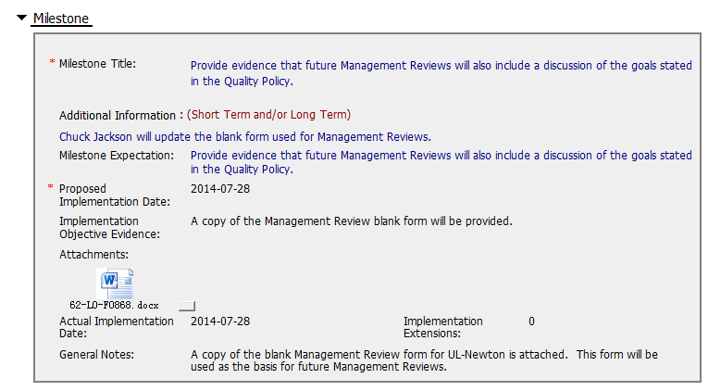
CAR No. 143913471 (5)_(Milestone 2)
Milestone 2 aims to resolve the “record incomplete” issue shown in “Category” item. Not as long term action , but containment action.
The attachment 62-LO-F0868 (Laboratory Management Review Report)shows “DISCUSSION OF MEASURABLE GOALS “ were added in item “1.Suitability of policies and procedures”, but other contents are the same as controlled Form 00-LC-F0033. Not clear why it’s acceptable again since disapproval for 1st time.
Suggest to improve “Expectation” ,as below.
- The evidence that addressed the root cause – not understood requirement” issue.
- KMS e-mail for the revised and published form adding “discussion of measurable goals” item
- Evidence (e-mail, meeting minutes )for training or communication of the updated form.
Should have final milestone for owner’s verification of effectiveness.
Expectation could cover :
- Verify whether the stakeholders know about the NC raised and current measurable goals/objectives of their functions..
- Communication timely and effectively of the measurable objectives performance after reviewed in MR.
- Check any actions items if not met objectives.
(C) Milestones completed per milestone expectations – Need Improve
Notes:
00-QA-S0006 (#18.0) - Corrective Action Request Process

Slide 8
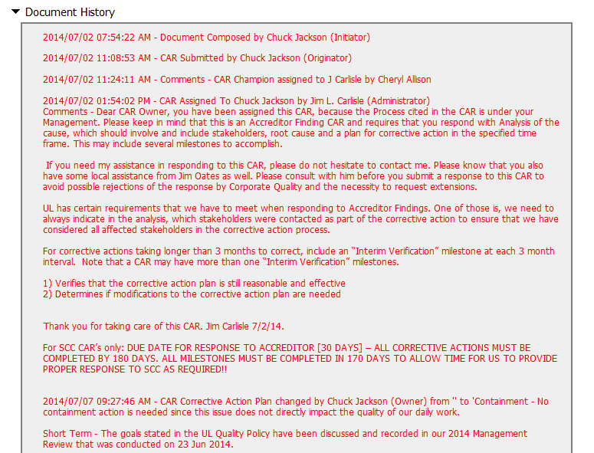
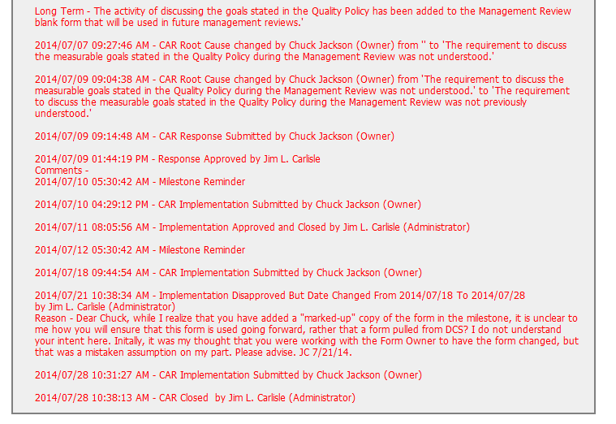
CAR No. 143913471 (6)
Very clear instructions for owner to response CAR. Excellent!
The 2nd milestone evidence was initially disapproved ,as form 62-LO-F0868 was originated from controlled 00-LC-F0033 Lab MR report ,just by adding “discussion measurable goals” item
Not clear why 2nd time it’s acceptable
(L) Referenced communications are attached as needed – Excellent
(T) Acts on CARs within required timeframe – Excellent
(C) No Extensions, No overdue, No escalated, No disputed – Excellent
Notes:
00-QA-S0006 (#18.0) - Corrective Action Request Process

Slide 9
CAR Review
Team A:
Mel Fehrenbacher, Matthew Marotto, Barbara Scala

Slide 10
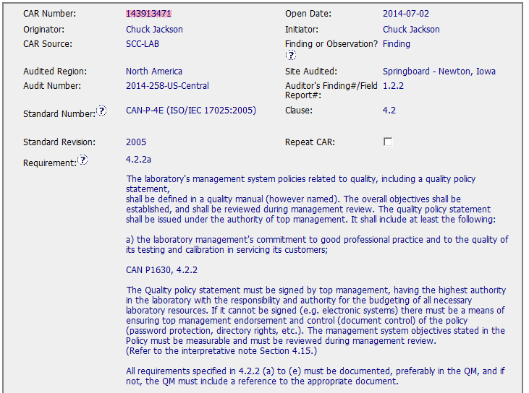
CAR 143913471
All the fields were correctly completed

Slide 11
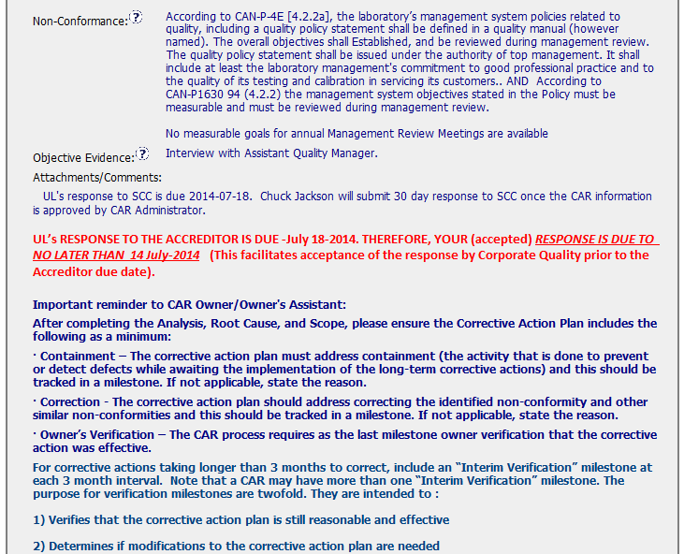
CAR 143913471
Guidance to CAR Owner is clear and complete.

Slide 12
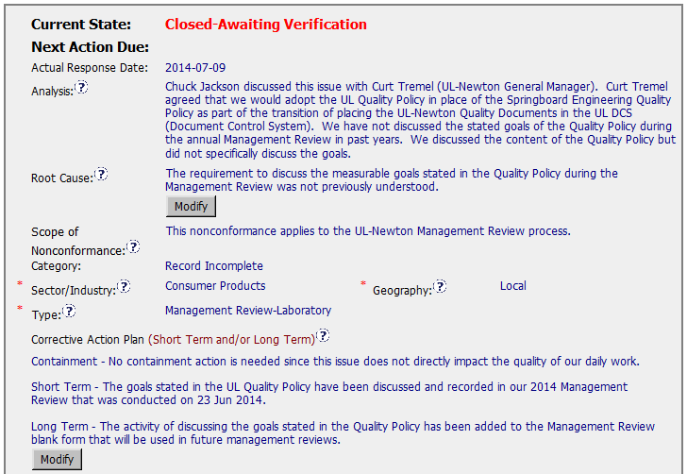
CAR 143913471
Analysis was not performed using the 5 why method, the “problem” has not been detected.
Root cause only based on misunderstanding.
Category should not be ‘Record Incomplete’ but ‘Process Implementation or Deployment Issue’

Slide 13
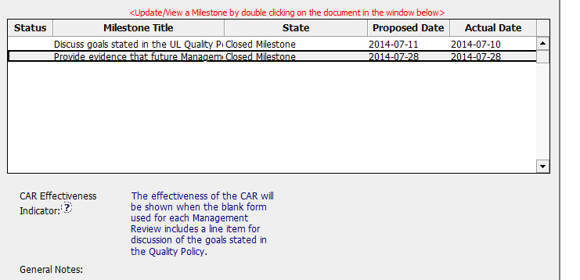
CAR 143913471
Verification milestone is missing, provide a blank form with a line item for discussion of the goals does not assure that the problem gets resolved: that dedicated space for discussion may not be filled out.

Slide 14
CAR 143913471 - CBS
INTEGRITY: Initiative & Decision Making / Analyzing & Problem Solving
Facilitates progression of the CAR through closure: extensions, escalations, reassignments, etc. (+)
Accurately completes the administrative fields within the CAR such as root cause category, process impacted, geography, etc. (+)
Acts on CARs within the required timeframe (+)
Most appropriate ‘category’, ‘type’, ‘geography’ are selected (-)

Slide 15
CAR 143913471 - CBS
COMPETIVENESS: Customer Focus / Achieve Business Results / Flexibility
Assists customers as they address all aspects of the CAR – analysis, root cause statement, milestone, containment, verification, etc. (+)
Verifies CARs timely (+)
Analysis shows clear path to root cause and scope; stakeholders identified (-)
Root cause statement is succinct, reasonable, complete (-)
Corrective actions fix the objective evidence and other problems found; address entire root cause and scope. (+)
Milestones address containment & owner’s verification; completed per milestone expectations(-)
Verification per requirements (-)
COLLABORATION: Leading & Engaging / Teamwork / Communication
Provides pertinent feedback at appropriate times; shares information and keeps others informed (+)

Slide 16
CAR 143913094 Exemplary
Presented by Jeff Lietz

Slide 17
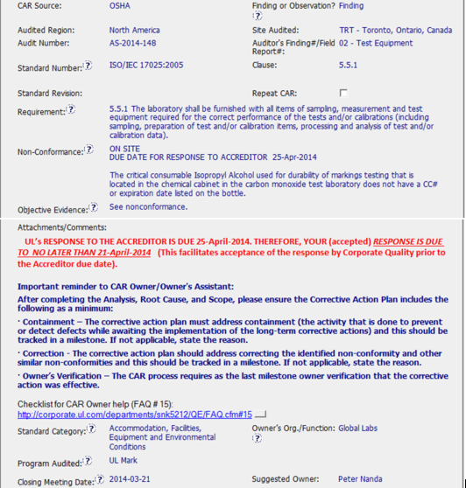
Clear requirement.
Accreditor due date and response date clearly stated.
Clear instructions to the CAR Owner.
Correct category.
Notes:
This started as a well-written CAR.

Slide 18
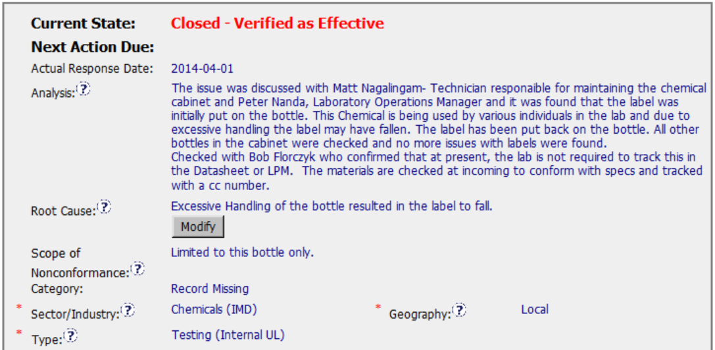
Stakeholders identified in Analysis
Analysis of the nonconformance items.
Additional checks to determine scope.
Succinct root cause statement.
Correct alignment with Category, Industry, Type, and Geography
Good linkage from nonconformance through Analysis to Root Cause
Notes:
Complete thorough Analysis leading to a succinct root cause statement. Although CAR scope was local, Owner planned to consult with other offices to maximize the learnings from this CAR.

Slide 19
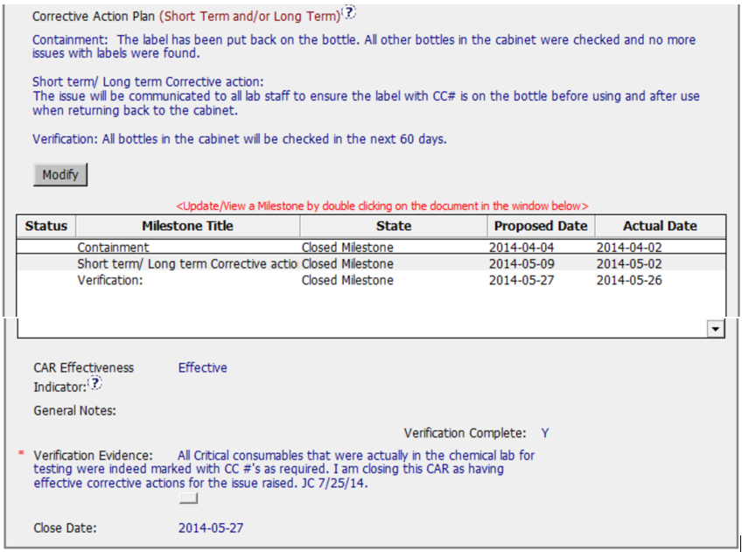
Corrective Action Plan completely described in text.
All milestones correspond to each element of the corrective action plan.
Effectiveness Indicator could have been more descriptive.
Verification executed within reasonable timeframe and succinct.
The CAR was completed in a timely manner within the planned timeframes.
Notes:
Corrective Action Plan text is supported with milestones for each component. Effectiveness Criteria is very clear and complete, and the CAR was completed in a reasonable timeframe.

Slide 20
Study for CAR# 143913473 by Tony Hsu

Slide 21
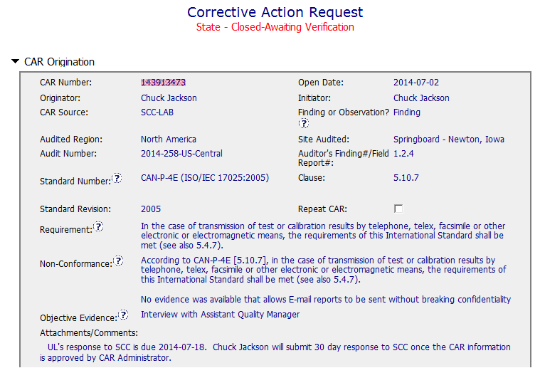
CAR 143913473
The Non-Conformance did not specify which ISO 17025 clause 5.4.7 related. However, we could know the key words

Slide 22
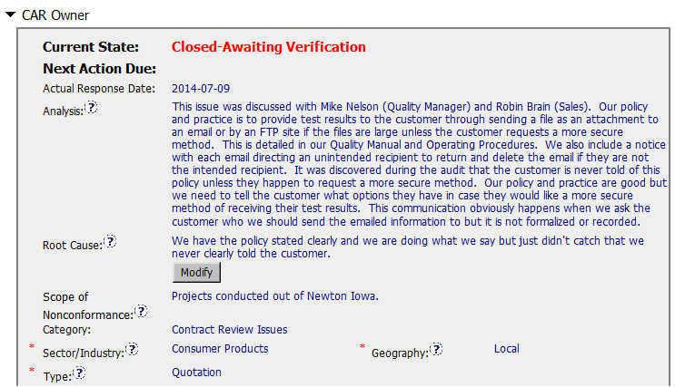
CAR 143913473
Explain the policy & practice for test report deliver to customer via email or FTP.
Analysis clearly identify for auditor’s concerns and save face for operation (Policy and practice are good but …).
(T) Most appropriate ‘category’, ‘type’, ‘geography’ are selected – Excellent
(C) Analysis shows clear path to root cause and scope; stakeholders identified – Excellent
(C) Root cause statement is succinct, reasonable, complete (Shows ‘N/A’ for observations) – Moderate

Slide 23
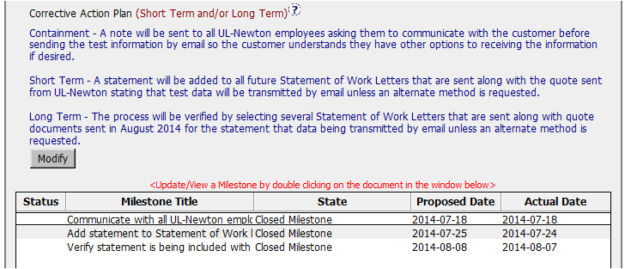
CAR 143913473
See Milestone 2, the sentence did not includes “an alternate method is requested”.
(C) Corrective actions fix the objective evidence and other problems found; address entire root cause and scope. - Moderate
(C) Milestones address containment & owner’s verification – Moderate

Slide 24
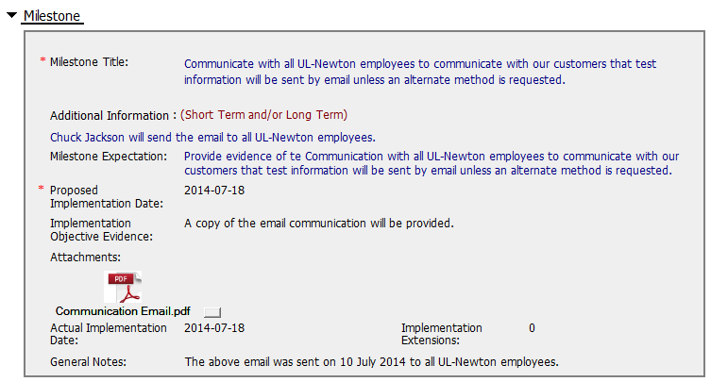
CAR 143913473 – Milestone 1
(C) Milestones completed per milestone expectations - Moderate

Slide 25
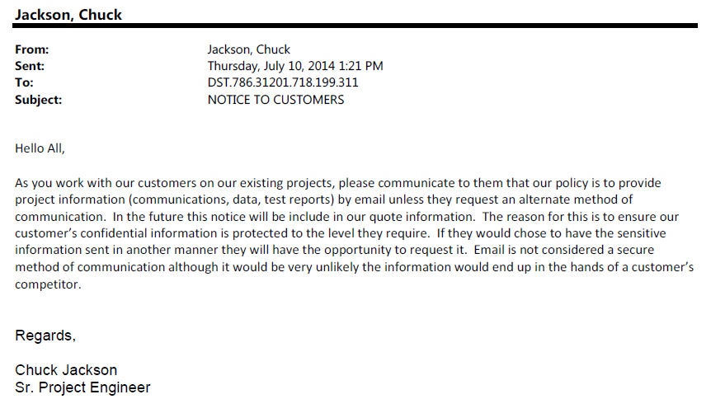
CAR 143913473 – Milestone 1
In the future this notice will be include in our quote information.

Slide 26
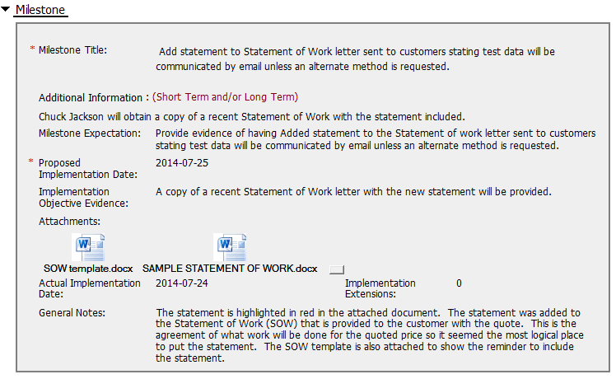

CAR 143913473 – Milestone 2
The statement did not mention “option” or “alternative method” other than email to meet confidential policy.
(C) Milestones completed per milestone expectations – Need Improve

Slide 27
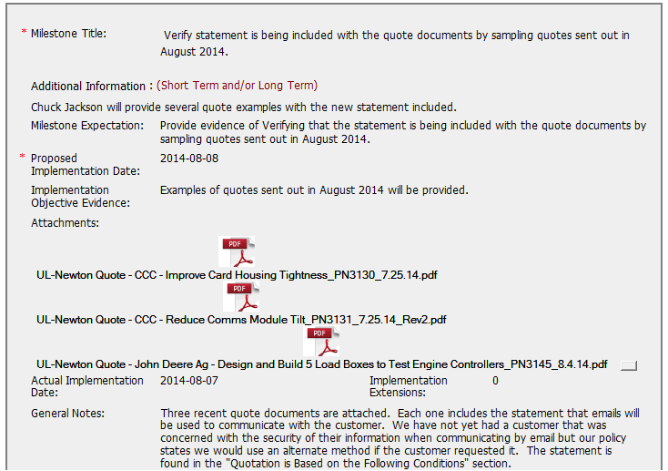
CAR 143913473 – Milestone 3
(C) Milestones completed per milestone expectations - Moderate

Slide 28
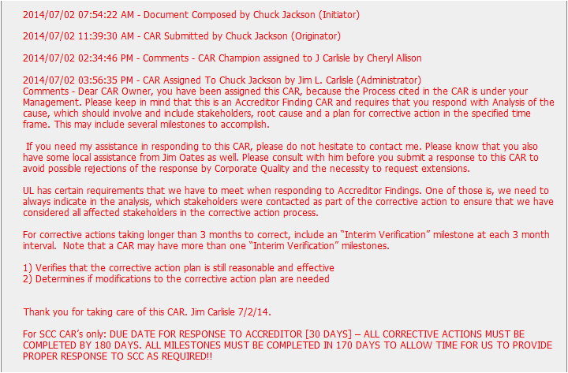
CAR 143913473 – History Study 1
The comment shows communication for supporting the CAR Owner and clarify the action CAR Owner needed.
(L) Referenced communications are attached as needed – Excellent

Slide 29
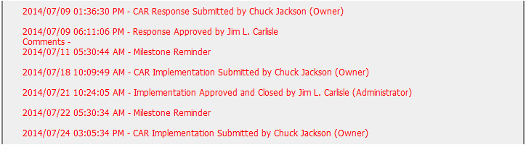
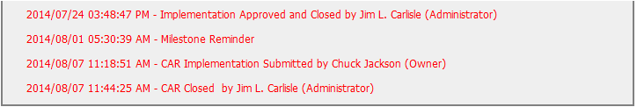
CAR 143913473 – History Study 2
The CAR initiated on Jul 2 and closed on Aug 7, only for 36 days. No extensions, no overdue, no escalated. Excellent!
(T) Acts on CARs within required timeframe – Excellent
(C) No Extensions, No overdue, No escalated, No disputed – Excellent

Slide 30
CAR 143913473 – CBS Check
CBS Requirements | Excellent | Moderate | Need Improve | N/A
(C) Extensions are within requirement (<30 days, 3 or less) |  |  |  | X
(T) Most appropriate ‘category’, ‘type’, ‘geography’ are selected | X
(P) Facilitates the handling of disputed CARs |  |  |  | X
(T) Acts on CARs within required timeframe | X
(C) Analysis shows clear path to root cause and scope; stakeholders identified | X
(C) Root cause statement is succinct, reasonable, complete (Shows ‘N/A’ for observations) |  | X
(C) Corrective actions fix the objective evidence and other problems found; address entire root cause and scope. For observations, they do not go beyond fixing the objective evidence |  | X
(C) Milestones address containment & owner’s verification; completed per milestone expectations |  |  | X
(P) Verification per requirements |  |  |  | X
(L) Referenced communications are attached as needed | X
(C L) Evidence of communication for overdue/escalated CARs and other pertinent concerns |  |  |  | X
(P) Trains other CAR Champions |  |  |  | X

